Slide 1
Finance Credit Team Sprint Status Update
Lucas | Kendall | lakendal@mtu.edu
Trent | Magers | tfmagers@mtu.edu
Emily | Wood | Ewood@mtu.edu
Reyn | White | walterw@mtu.edu
Irene | Trierweiler | Iltrierw@mtu.edu
Joseph | Williams | jokwilli@mtu.edu
Atharva | Joshi | atharvaj@mtu.edu

Slide 2
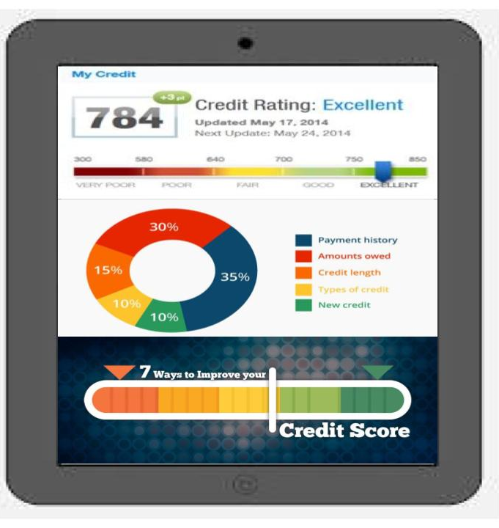
Credit Tracker
Features:
Credit Score Tracking
Loan Review
Payment History
Credit Mix Tracking
Loan Balances Breakdown
Personal
Student
Auto
Mortgages
Credit
Medical

Slide 3
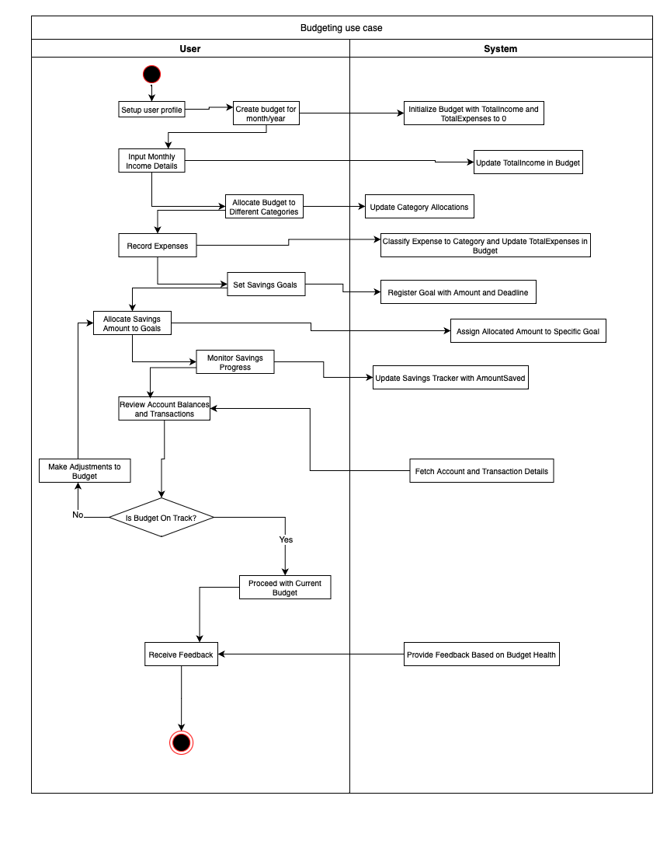
Budgeting Process Map
User - Creates -> Budget
Budget - Contains -> Expense
Budget - Contains -> Income
Budget - Has -> BudgetCategoryAllocation
Category - Allocated in -> BudgetCategoryAllocation
Category - Categorized as -> Expense
User - Sets -> Goal
Goal - Has -> Allocation
Goal - Tracked by -> SavingsTracker
User - Provides -> Feedback
User - Owns -> Account
Account - Registers -> Transaction
Category - Categorized as -> Transaction

Slide 4
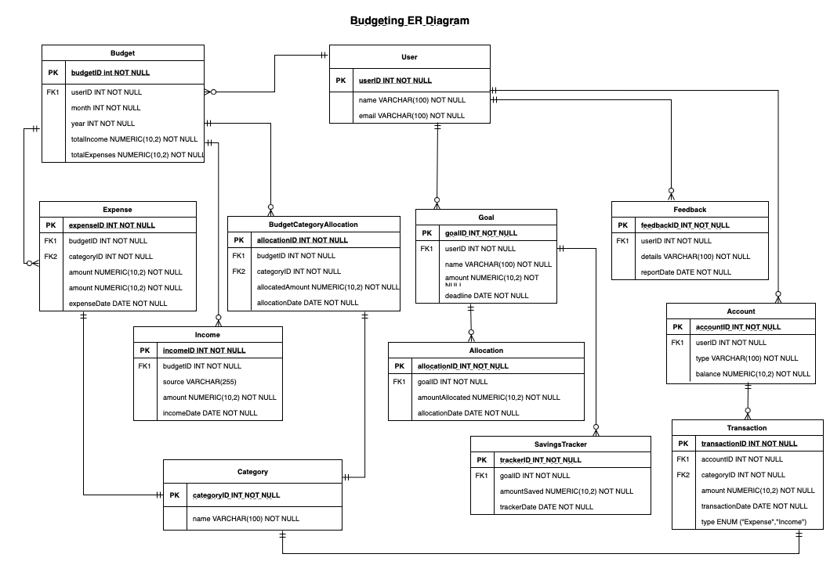
Budgeting ER Diagram

Slide 5
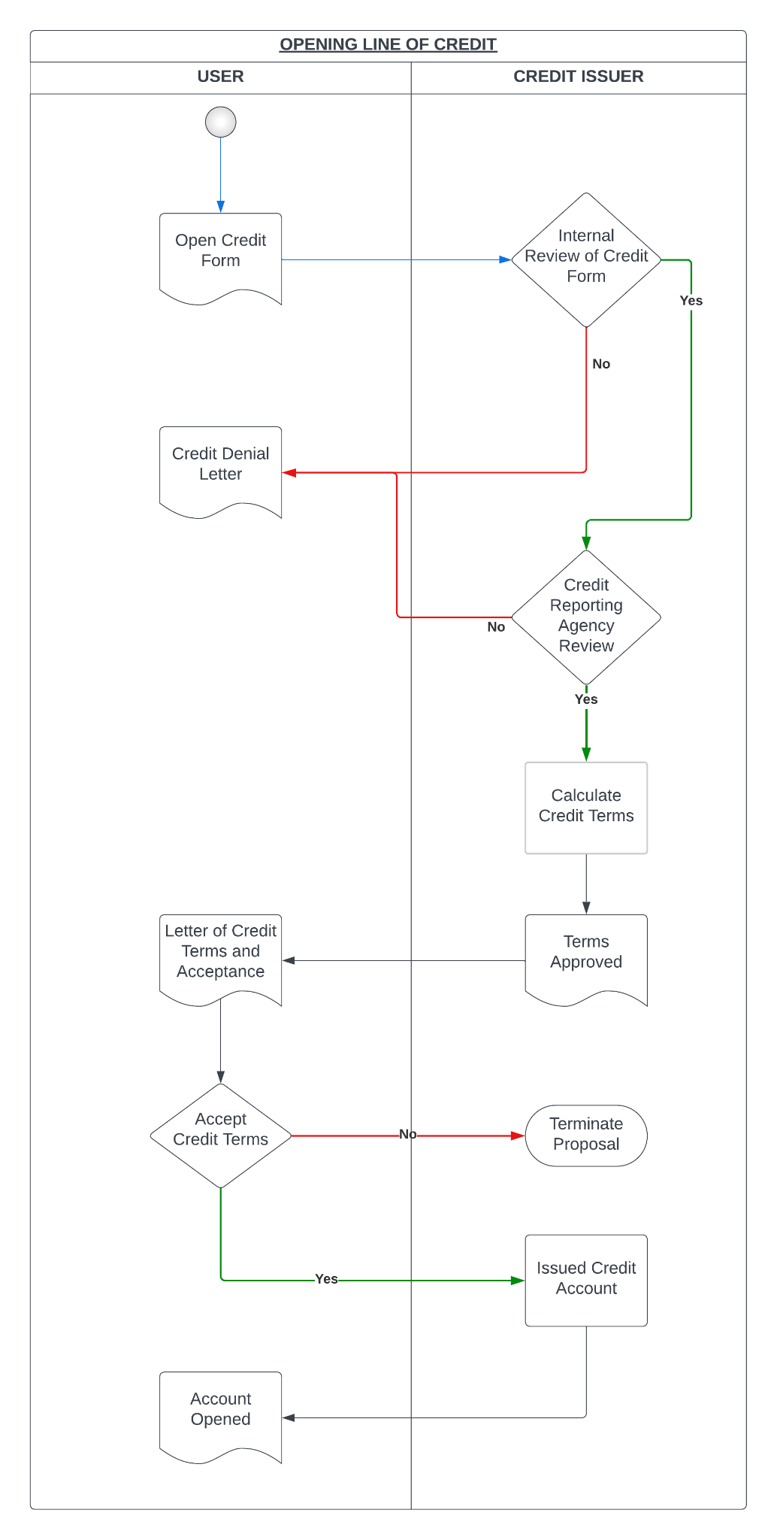
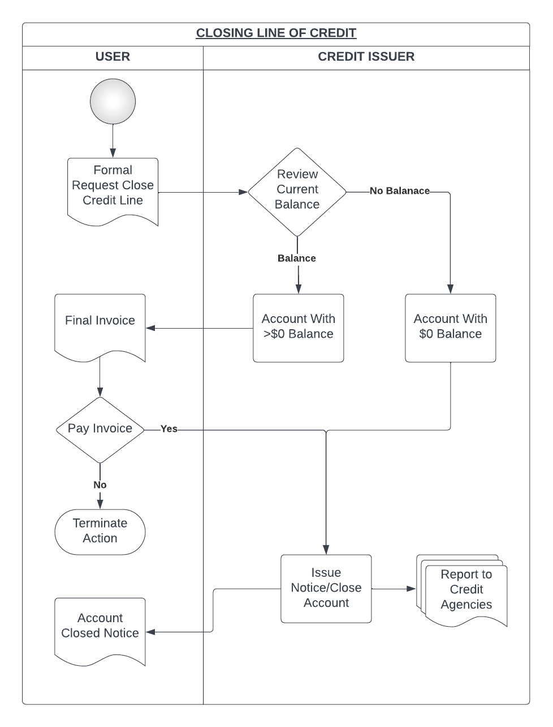
Process Map/ER Development

Slide 6
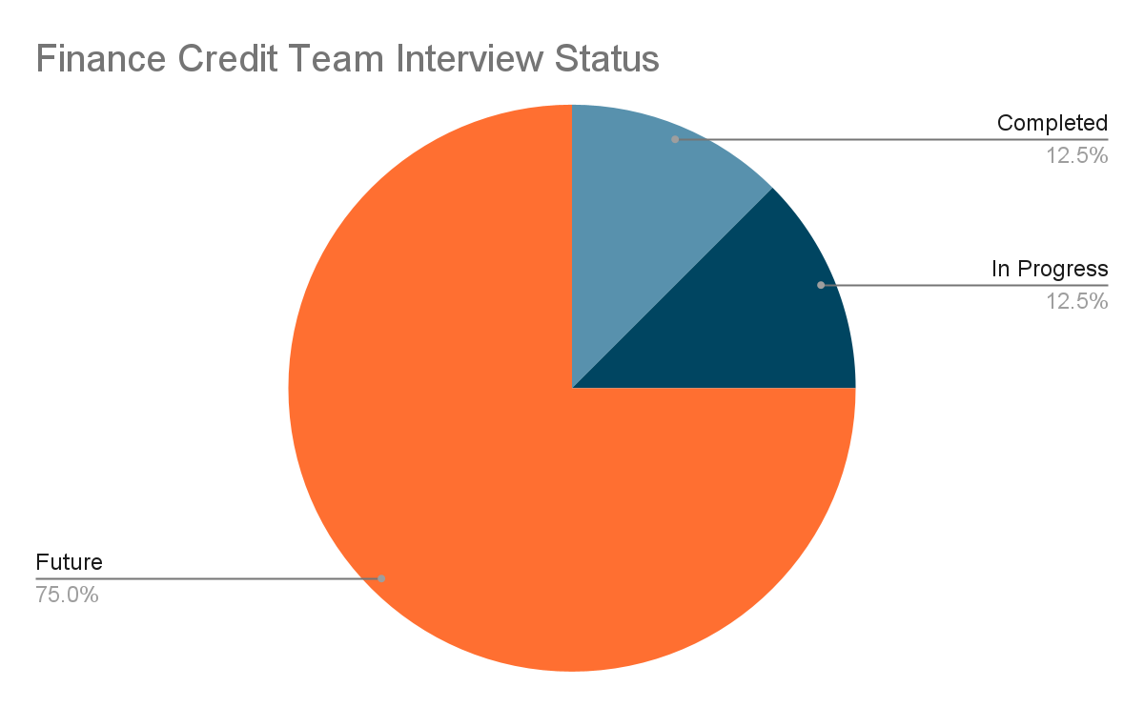
Interviews Status

Slide 7
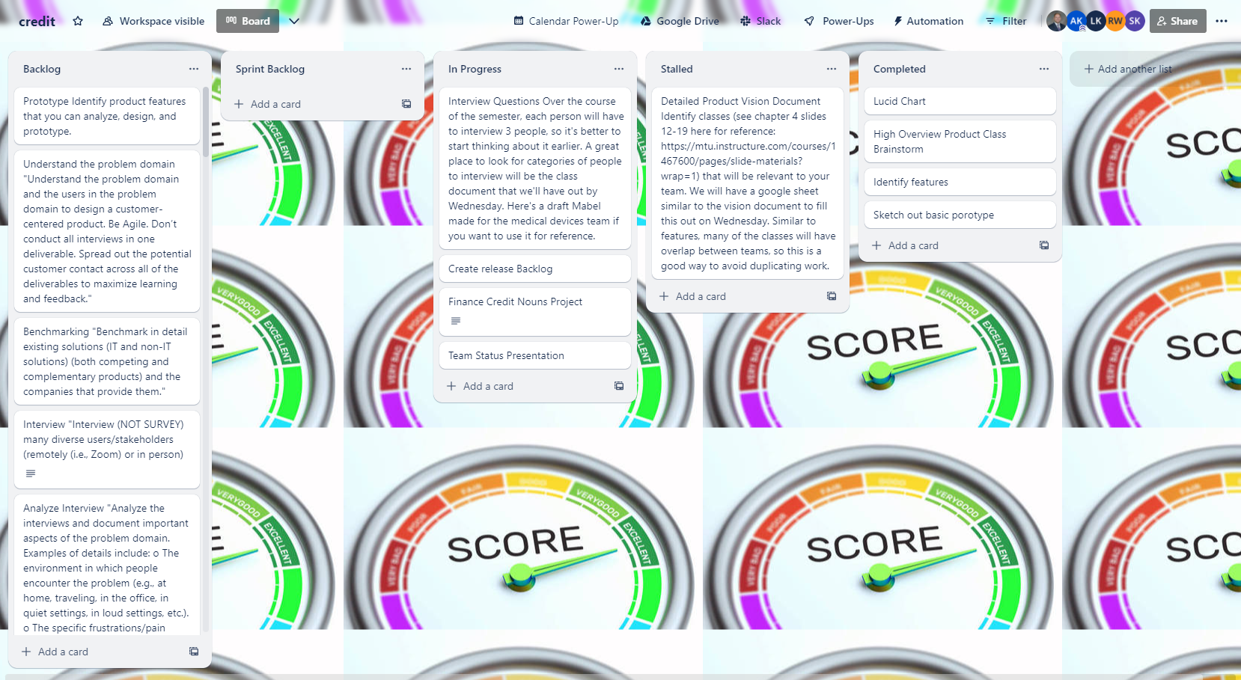
Trello Migration

Slide 8
Tasks/Goals In Flux
Activity Diagrams, Entities, Attributes, Etc
Banking Activity.
Credit Score Trackability.
Loan/Borrowing.
Purchasing.
Interviews
Completing 2 in progress interviews.
Driving 12 interviews during the progression of the semester.
Continuous Improvement on Trello project tracking.
Finalizing system processes for credit module.

